Slide 1
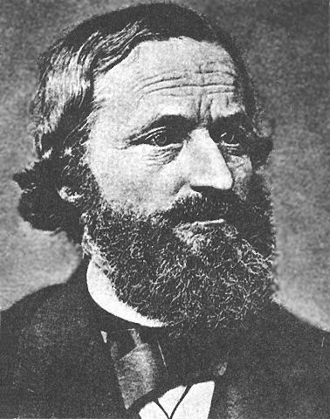
Basic Electric Circuits
18-2 Multiloop Circuits and Kirchhoff
FYI: Each branch has its own current.
•Solving a circuit consists of finding unknown currents, the current direction, and the voltages in a circuit.
•A multiloop circuit has more than one loop, and sometimes more than one battery.
•A junction (or node) is a point in a circuit where three or more connecting wires are joined together.
•A branch is a path connecting two junctions.
A
I₁
100 Ω
I₃
50 Ω
I₂
-
15 V
+
10 V
25 Ω
+
-
50 Ω
Snoop Dog Kirchhoff
B
Notes:
© 2006 By Timothy K. Lund

Slide 2
Basic Electric Circuits
18-2 Multiloop Circuits and Kirchhoff
FYI: This means that the sum of the currents going into a junction equals the sum of the currents leaving it.
FYI: The junction theorem is just a statement of the conservation of charge.
FYI: The convention is to assign a (+) to currents entering a junction, and a (-) to currents leaving the junction:
•Start by assigning arbitrary directions to your branch currents:
•Kirchhoff's first rule (the junction theorem) states that the algebraic sum of the currents at a junction is zero.
FYI: At this point we have but 1 equation with three unknowns.
ΣI = 0
Kirchhoff's
Junction
Theorem
I₁
I₃
A
I₁
I₁
ΣI = 0
I₂
100 Ω
I₃
50 Ω
(junction A)
I₂
-
I₃ - I₁ - I₂ = 0
15 V
+
I₁
10 V
I₂
25 Ω
I₃
+
-
50 Ω
(junction B)
B
I₁ + I₂ - I₃ = 0
I₁
I₁
I₃
Notes:
© 2006 By Timothy K. Lund

Slide 3
Basic Electric Circuits
18-2 Multiloop Circuits and Kirchhoff
FYI: The loop theorem is just a statement of the conservation of energy.
FYI: A few conventions are used to determine whether the voltage difference is positive or negative. Here they are:
• Traveling through a resistor in the direction of the current is a voltage DROP (-).
•Now we look at the voltages in any loop and invoke the second of Kirchhoff's rules:
• Traveling through a resistor opposite to the direction of the current is a voltage GAIN (+).
•Kirchhoff's second rule (the loop theorem) states that the algebraic sum of the voltage differences in any closed loop is zero.
• Traveling through a battery from (+) to (-) is a voltage DROP (-).
• Traveling through a battery from (-) to (+) is a voltage GAIN (+).
I₁
I₃
Kirchhoff's
Loop
Theorem
A
ΣV = 0
I₁
I₂
100 Ω
50 Ω
-
15 V
+
I₁
10 V
I₂
25 Ω
I₃
+
-
50 Ω
B
I₁
I₁
I₃
Notes:
© 2006 By Timothy K. Lund

Slide 4
Basic Electric Circuits
18-2 Multiloop Circuits and Kirchhoff
FYI: Counting the junction theorem equation, we now have three equations with three unknowns.
•For loop 1:
15 - 50I₁ + 10 + 100I₂ - 50I₁ = 0
25 - 100I₁ + 100I₂ = 0
1 = 4I₁ - 4I₂
•For loop 2:
-10 - 25I₃ - 100I₂ = 0
-2 = 5I₃ + 20I₂
I₁
I₃
A
I₁
(junction A)
I₃ - I₁ - I₂ = 0
I₂
100 Ω
50 Ω
-
2
15 V
1
+
I₁
10 V
I₂
25 Ω
I₃
+
-
50 Ω
B
I₁
I₁
I₃
Notes:
© 2006 By Timothy K. Lund

Slide 5
Basic Electric Circuits
18-2 Multiloop Circuits and Kirchhoff
FYI: The (-) in the I₂ means that we picked the wrong direction.
FYI: The (+) in the I₁ means that we picked the right direction.
1 = 4I₁ - 4I₂
5 = 20I₁ - 20I₂
8 = -20I₁ + -100I₂
-2 = 5I₃ + 20I₂
13 = -120I₂
-2 = 5(I₁ + I₂) + 20I₂
I₂ = -13/120 A
-2 = 5I₁ + 25I₂
I₃ - I₁ - I₂ = 0
5 = 20I₁ - 20(-13/120 )
5 = 20I₁ + 13/6
I₃ = I₁ + I₂
30 = 120I₁ + 13
I₃ = 17/120 + -13/120
17 = 120I₁
I₃ = 4/120
I₁ = 17/120 A
I₃ = 4/120 A
FYI: If you need to find any of the resistor voltages just use Ohm’s law: V = IR.
Notes:
© 2006 By Timothy K. Lund

